Slide 1

Object Detection of PPE used on Construction Site using YOLOv3 and Transfer Learning
M.Tech Project Presentaion
on
By
Sankarlal R
(Roll No. 173040063)
Under the guidance of
Prof. Venkata Santosh Kumar Delhi
Construction Technology and Management
Department of Civil Engineering
IIT Bombay

Slide 2
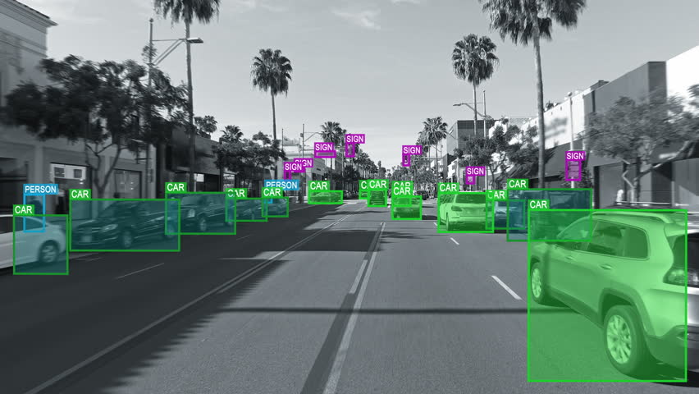
Computer Vision
Field that works on enabling computers to see and visually sense the world around them in the same way that human vision does
Concerned with the automatic extraction, analysis and understanding of useful information from a single image or a sequence of images
Ref: https://www.shutterstock.com/video/clip-33521560-autonomous-driverless-car-computer-vision-object-detection

Slide 3
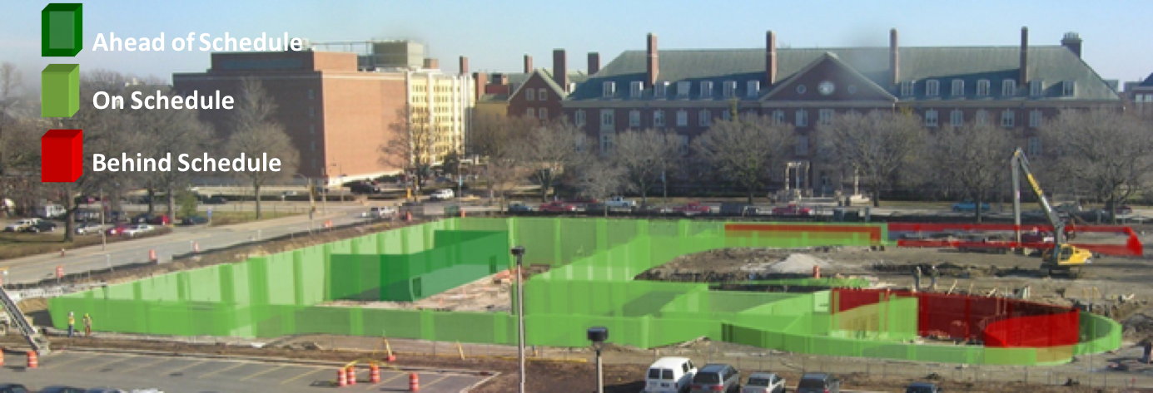
Computer Vision in Construction Management
Fundamental requirements for collecting information at a construction site using computer-vision technology are to
recognize workers
construction equipment
materials in image data
Computer vision has attracted much attention because it can provide visual information over a large area at relatively low cost and is simple to use.
Ref: https://medium.com/reconstruct-inc/what-ai-can-do-for-progress-monitoring-b47526fece5f
Notes:
Visible spectrum-based imaging approaches (conventional RGB)
Simultaneous Localization and Mapping (SLAM) technique to estimate real-time positions and orientations of the robot
photogrammetry-based approach
Deep Thermal Imaging:
Proximate Material Type Recognition in the Wild through Deep Learning of Spatial Surface Temperature Patterns

Slide 4
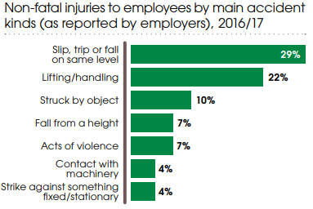
Safety in Construction
As per Occupational Safety and Health Administration (OSHA) report
approximately 1 in 10 workers is injured on job site every year
In Great Britain € 14.9 billion is the estimated cost of injuries and ill health from current working conditions (HSE statistics 2016/17)
In current world scenario, it is infeasible for dedicated safety experts to visit each site
Where as computer vision engines can enhance and assure better safety standards and robust implementation at optimal cost
Cynthia L Roth (2011)
Ref: http://www.hse.gov.uk/statistics/overall/hssh1617.pdf
Notes:
Visible spectrum-based imaging approaches (conventional RGB)
Simultaneous Localization and Mapping (SLAM) technique to estimate real-time positions and orientations of the robot
photogrammetry-based approach
Deep Thermal Imaging:
Proximate Material Type Recognition in the Wild through Deep Learning of Spatial Surface Temperature Patterns

Slide 5
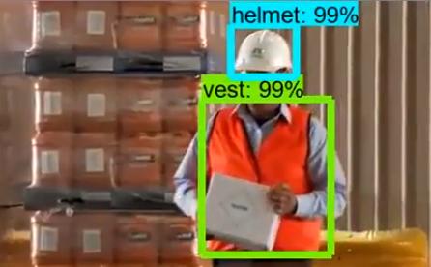
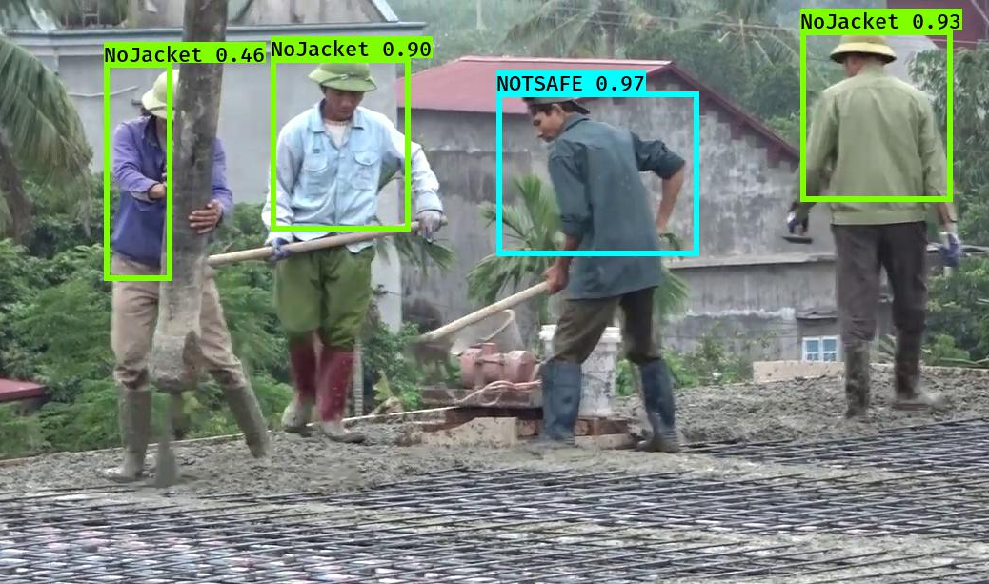
Research Gap
Currently networks are implemented to identify hardhat & Jacket as two objects
In the developed Model
Uses a faster network
Single bounding box is drawn for a person predicting the person to be safe / unsafe
provides with a decision instead of just detection
New features considering old Models
Saving NOTSAFE instances to date wise folders
Date wise report generation
Ref: https://www.youtube.com/watch?v=PvPzmHLi_i0

Slide 6
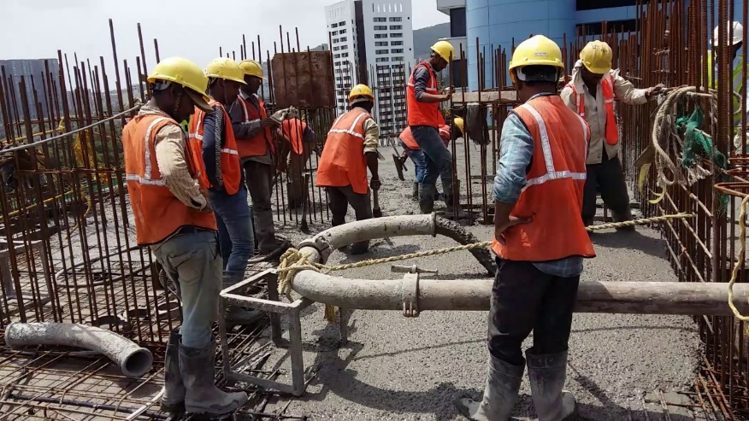
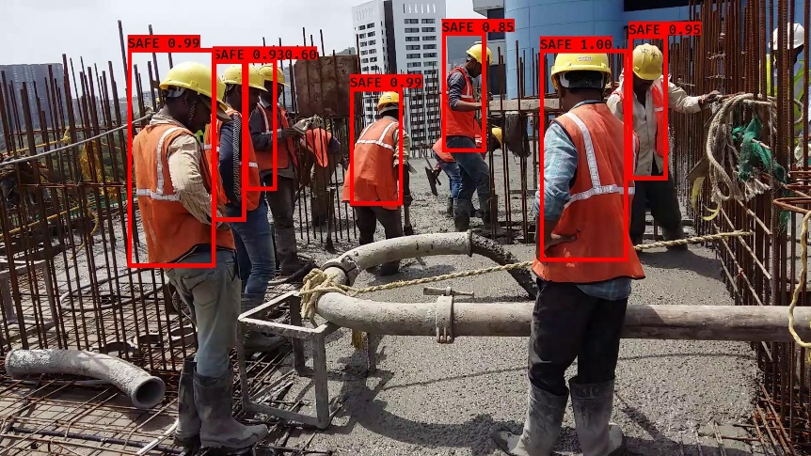
Objective
Detection of Personal Protective Equipment (PPE) used in construction industry to ensure proper usage of PPE
Develop Convolutional Neural Network (CNN) model by applying Transfer Learning to You Only Look Once (YOLOv3) algorithm
Generate date-wise report of Unsafe personnel found on site with image, date and timestamp.
Image Processing
Object Detection
Bounding Box Drawing
YOLOv3

Slide 7

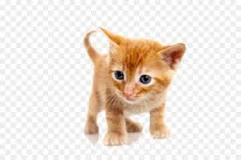
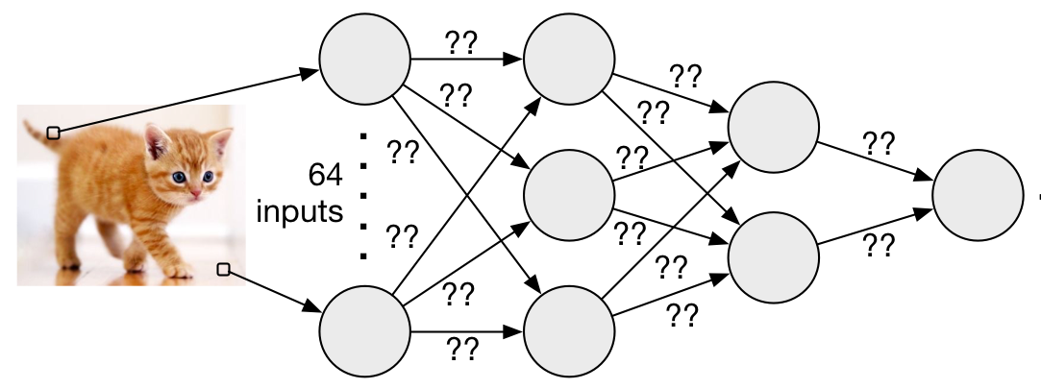

Neural Network
Program based on the way brain works
It’s a cat
It’s a cat
Ref: http://www.free-powerpoint-templates-design.com
https://homes.cs.washington.edu/~bornholt/post/nnsmt.html
https://depositphotos.com/33233003/stock-photo-robot-is-resting-and- watching.html

Slide 8
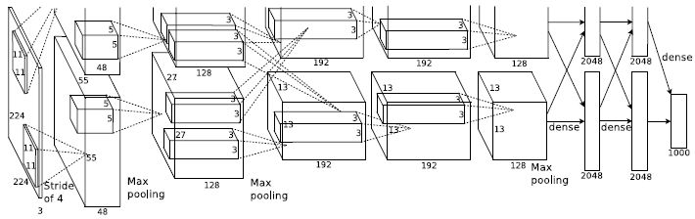
Convolutional Neural Network
Most commonly applied to analyse visual imagery
A CNN consists of an input and an output layer, as well as multiple hidden layers.
The hidden layers of a CNN typically consist of
Convolutional layers
Pooling layers
Fully connected layers
Matthew D. Zeiler and Rob Fergus (2013)
Ref: https://sushscience.wordpress.com/2016/12/04/understanding-alexnet/

Slide 9
Convolutional Layer
Convolution operation
Convolution operation
0*1 + 1*0 + 2*-1 +
5*1 + 8*0 + 9*-1 +
7*1 + 2*0 + 5*-1 = -4
3*1 + 0*0 + 1*-1 +
1*1 + 5*0 + 8*-1 +
2*1 + 7*0 + 2*-1 = -5
3 | 0 | 1 | 2 | 7 | 4
1 | 5 | 8 | 9 | 3 | 1
2 | 7 | 2 | 5 | 1 | 3
0 | 1 | 3 | 1 | 7 | 8
4 | 2 | 1 | 6 | 2 | 8
2 | 4 | 5 | 2 | 3 | 9
-5 | -4 | 0 | 8
-10 | -2 | 2 | 3
0 | -2 | -4 | -7
-3 | -2 | -3 | -16
-5
1 | 0 | -1
1 | 0 | -1
1 | 0 | -1
-5 | -4
*
FILTER
OUTPUT
INPUT
Ref: https://slideplayer.com/slide/6242102/

Slide 10
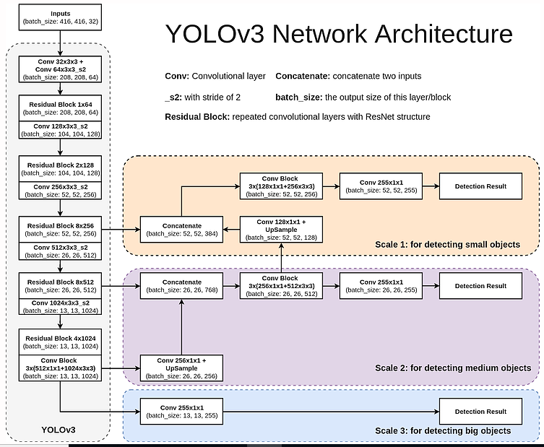
YOLOv3
106 convolutional layers
Darknet-53 used as feature extractor
Predictions done in 3 scales
Uses Multi-label classification
Ref: www.cyberailab.com/home/a-closer-look-at-yolov3

Slide 11
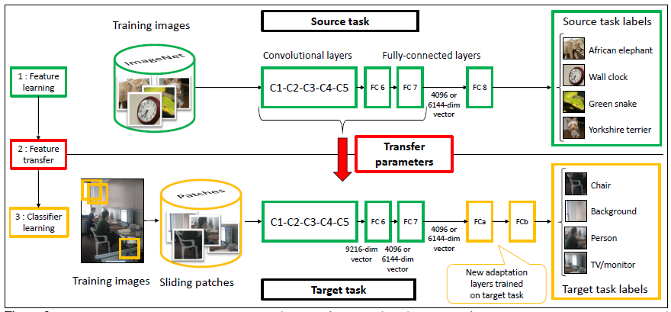
Transfer Learning
Stores knowledge gained while solving one problem
Apply it to a different but related problem
Person
Car
Bag
Dog
Cat
Person
Hardhat
Jacket
Andrew N G (2016)
Ref: https://blog.acolyer.org/2017/02/27/understanding-generalisation-and-transfer-learning-in-deep-neural-networks/

Slide 12
Network Modifications
Train-Validation split introduced to training model
Training code modified to save trained models and checkpoints in a folder with corresponding training date in the folder name
Modifications in evaluation code :
Batch processing of all images in a folder and save output in same folder
Alarm added if predicted class is NOTSAFE
Image saving if predicted class is NOTSAFE
New code introduced to generate report
Notes:
Concatenation – skip connection

Slide 13




Data Set Preparation
Data Collection
Manual Collection
Videos of Construction activity taken from site, converted to images by frame capture
Images collected: 260
Web Scraping
Automated web search & downloading of images
Images collected : 1500
Total number of Images collected: 1760
Data Augmentation
Augmentations
Image flipping
30 degree clockwise rotation
30 degree anticlockwise rotation
Final Dataset has 2509 images

Slide 14

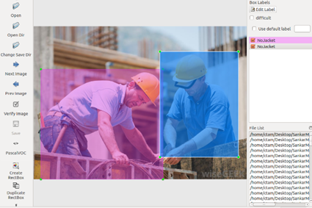
Data Set Preparation
Image Labelling
Using labelImg-master
Train, Validation & Test Set
 | Train | Validation | Test
No. of Images | 2217 | 238 | 54

Slide 15
Training
Initial model file created by combining cfg file & weights file
Classes
Adam optimizer with initial learning rate of 0.001
Learning rate reduction by a factor of 0.1 if validation loss stops improving
Early stopping: stops training when validation loss stops improving
NOTSAFE
NoHardhat
NoJacket
SAFE
Notes:
Learning rate reduction: 3 epochs
Early stopping: 10 epochs

Slide 16
Training
 | Stage 1 | Stage 2 | Stage 3
No. of epochs (before / after unfreezing all layers) | 500 / 500 | 50 / 50 | 50 / 50
Batch Size (before / after unfreezing all layers) | 8 / 4 | 4 / 2 | 4 / 2
Epoch at which training stopped | 509 | 92 | 70
Time taken | 9d 13h 55m 20s | 3d 11h 51m 45s | 2d 5h 8m 7s
Initial Loss | 6486 | 21.88 | 12.87
Final Loss | 21.88 | 12.87 | 12.06
Notes:
10 layers freezed
Train = 277 batches, 554 batches
Val = 59 batches, 119 batches

Slide 17
Training

Slide 18
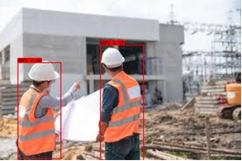

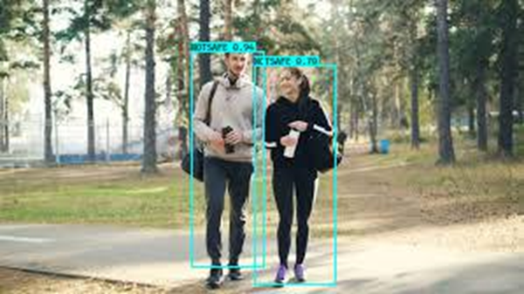
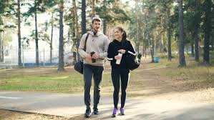
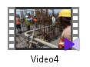
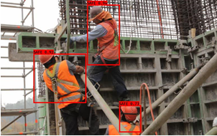
Working Model
Image Processing
Object Detection
Bounding Box Drawing
Images / Frames
INPUT
YOLOv3
OUTPUT 1: Predictions saved to Images Folder itself / new video file created with bounding boxes

Slide 19
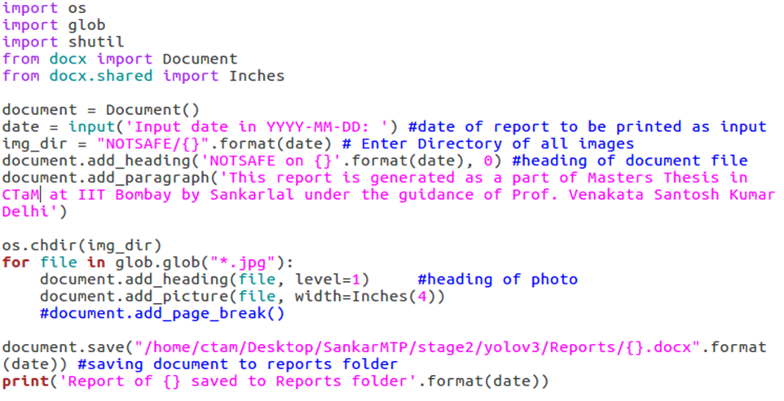
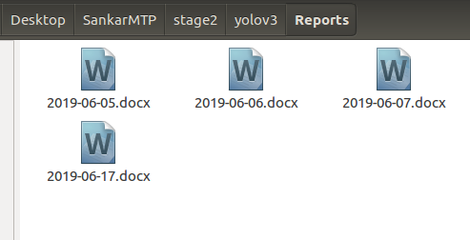
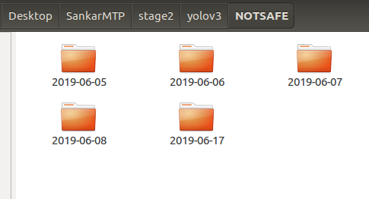
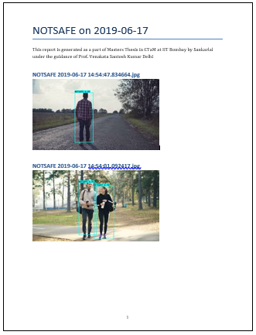

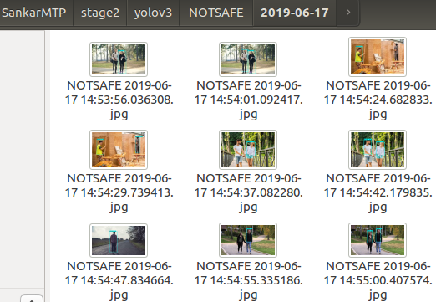
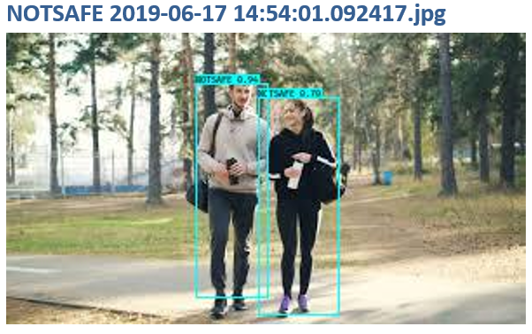
Working Model
Python code to generate report
OUTPUT 3: Date-wise Report of UNSAFE predictions
OUTPUT 2: NOTSAFE predictions saved to date-wise folder
Triggers Alarm for 5 sec
OUTPUT 1

Slide 20
Performance Evaluation
Performance measuring Parameters
Accuracy : Correctness of class prediction
Precision : Given a class prediction from the model, how likely is to be correct
Recall : Given a class, will the model detect it correctly
F1 score : Harmonic mean of precision and recall
Accuracy
Precision
Recall
F1 score

Slide 21
Performance Evaluation
Time taken for prediction:
Images : 4-6 s
Video frame rate: 2 FPS
 | Validation Dataset | Test Dataset | New Dataset
Accuracy | 0.96 | 0.96 | 0.96
Avg. Precision | 0.96 | 0.97 | 0.98
Avg. Recall | 0.96 | 0.97 | 0.95
Avg. F1 score | 0.96 | 0.97 | 0.96

Slide 22
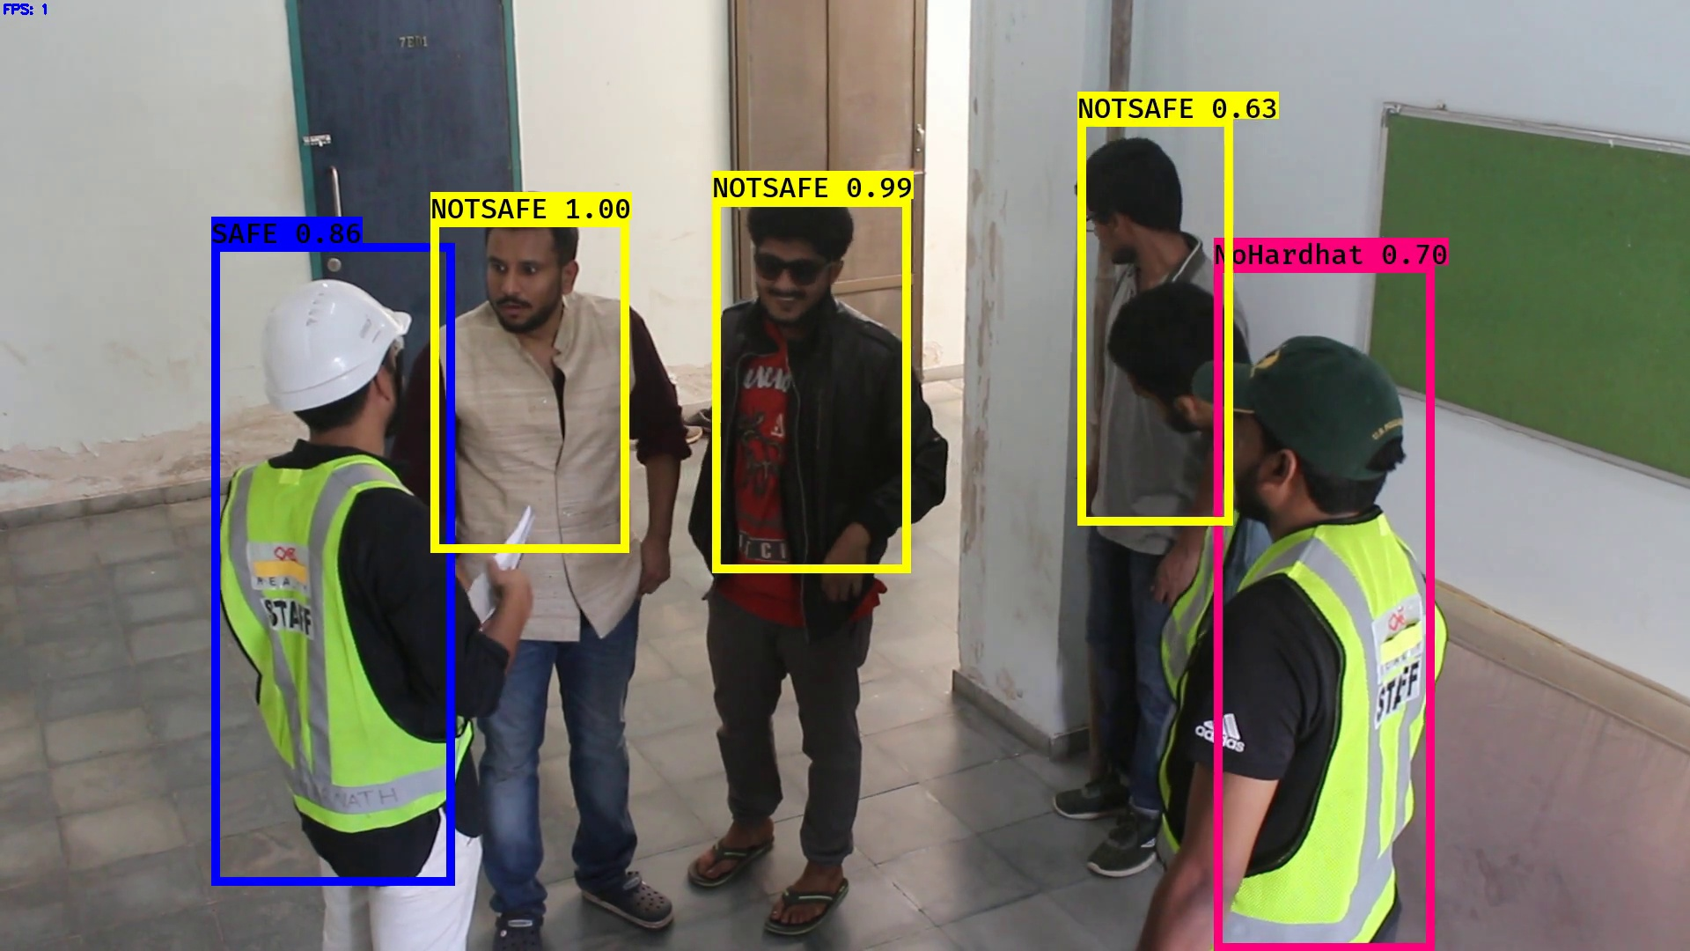
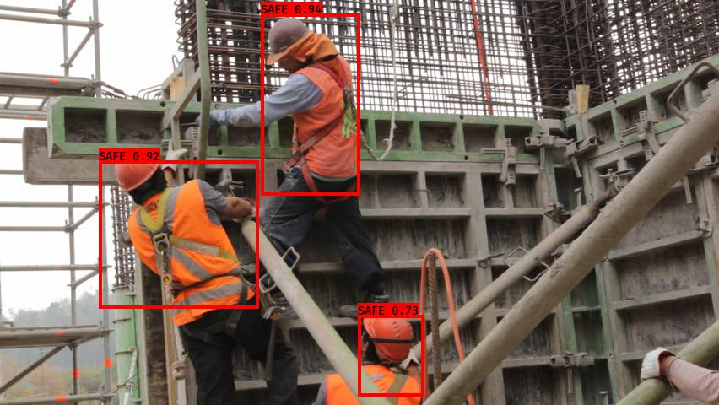
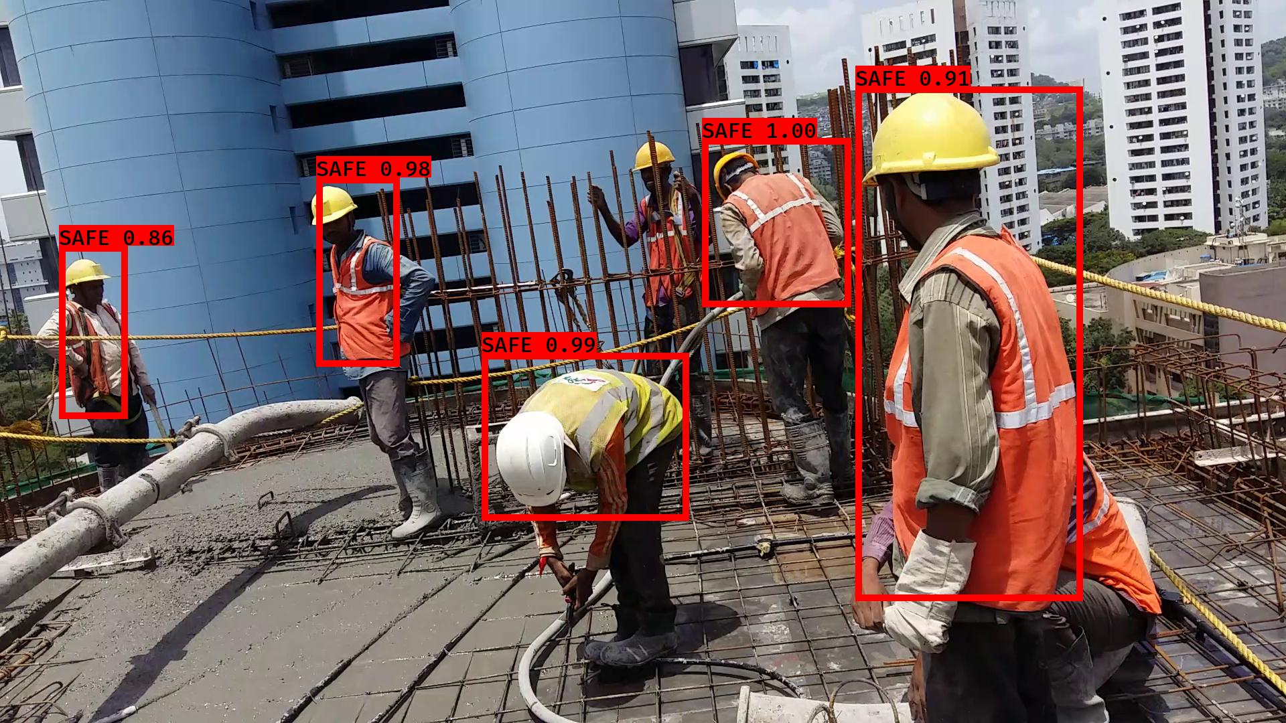
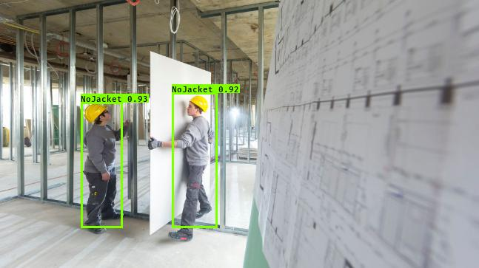
Predictions

Slide 23
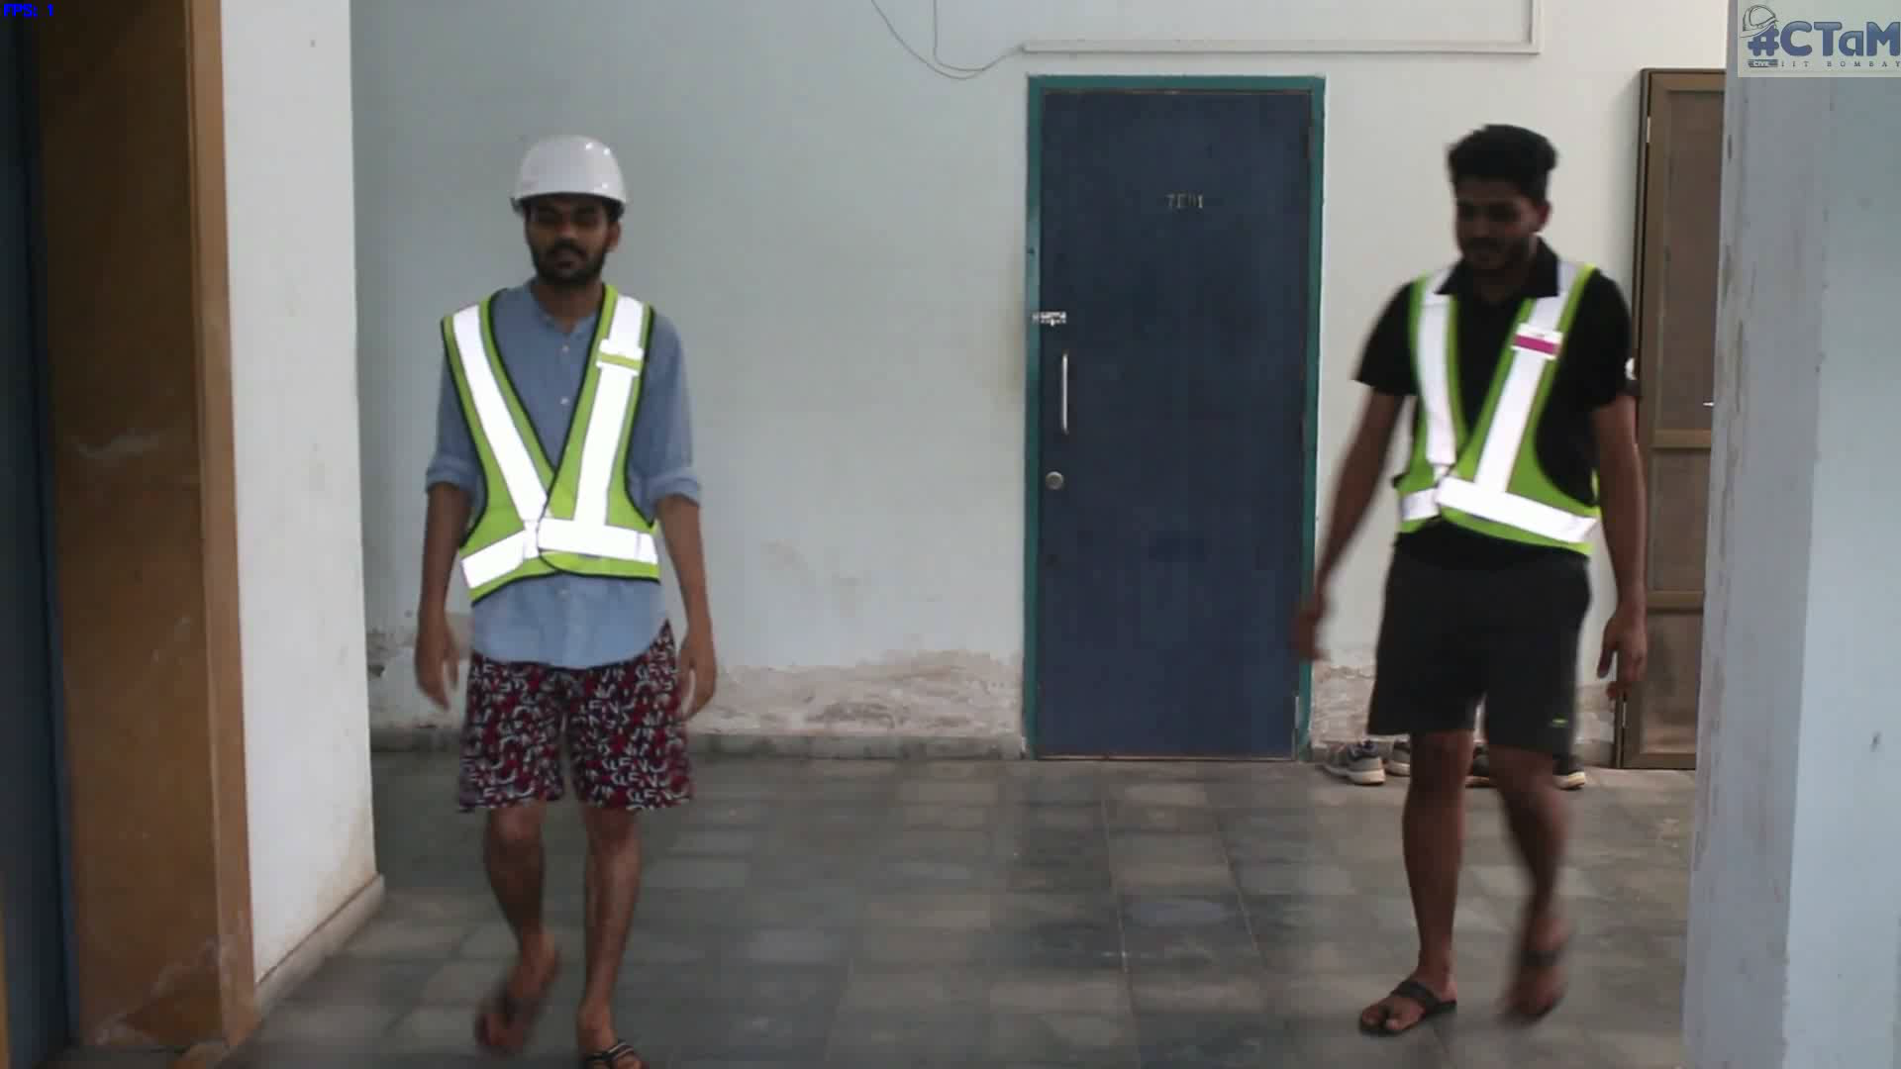
Predictions

Slide 24
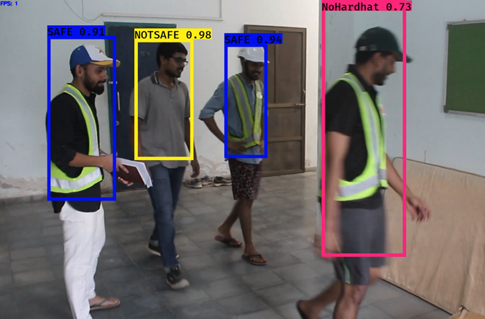
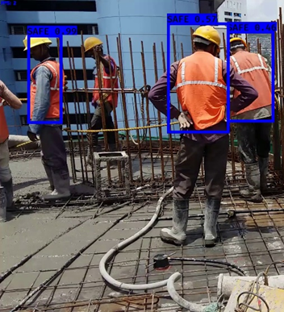
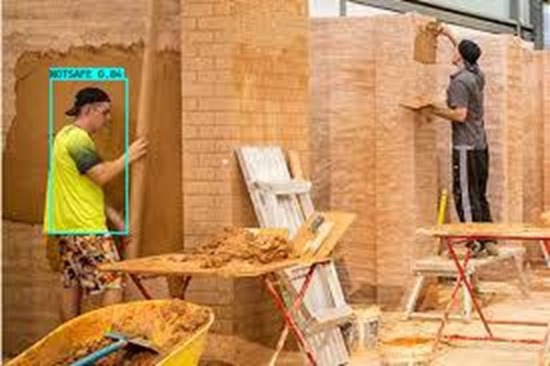
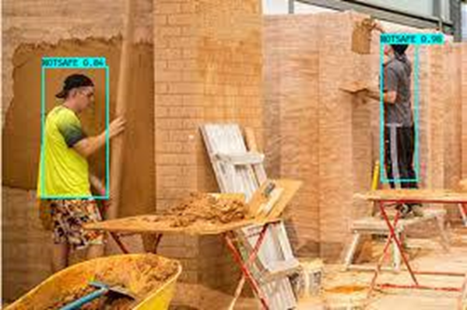
Limitations
Image gets saved after detecting each NOTSAFE class in single image
Person standing behind reinforcement bars not identified
Interprets blue / white cap as hardhat

Slide 25
Conclusion
Model has a Final Loss of 12.06
Model has an Accuracy of 0.97 and Average F1 score of 0.97 on the test data set
Model is predicting with an Accuracy of 0.96 and Average F1 score of 0.96 on the new data set
Hence the Model can be used on commercial basis for safety precautions
Final loss and Accuracy can be improved by training with more images

Slide 26
References
Joseph Redmon and Ali Farhadi, “YOLOv3: An Incremental Improvement”, 2018
Joseph Redmon and Ali Farhadi, “YOLO9000: Better, Faster, Stronger”, 2016
Joseph Redmon, Santosh Divvala, Ross Girshick and Ali Farhadi, “You Only Look Once: Unified, Real-Time Object Detection”, 2016
YOLO: Real-Time Object Detection, https://pjreddie.com/darknet/yolo/, Accessed on 23 October 2018, 9:00 hrs
What’s new in YOLO v3?, https://towardsdatascience.com/yolo-v3-object-detection-53fb7d3bfe6b, Accessed on 23 October 2018, 10:00 hrs
Ian Goodfellow, Yoshua Bengio, and Aaron Courville, “Deep Learning”, MIT Press, 2016
Matthew D. Zeiler and Rob Fergus, “Visualizing and Understanding Convolutional Networks”, 2013
Karanbir Chahal and Kuntal Dey, “A survey of Modern Object Detection Literature using Deep Learning”, 2018
Cynthia L Roth, Health and Safety: Hard Hats Guide, https://www.hsimagazine.com/article/head-protection-82, 2011, Accessed on 18 October 2018, 16:00 hrs
Health and safety statistics 2016/17, http://www.hse.gov.uk/statistics, Accessed on 24 October 2018, 16:00 hrs
Alex Krizhevsky, Ilya Sutskever, and Geoffrey E Hinton, “ImageNet Classification with Deep Convolutional Neural Networks”, 2012

Slide 27
References
Ali Sharif Razavian, Hossein Azizpour, Josephine Sullivan, and Stefan Carlsson, “CNN Features off-the-shelf: an Astounding Baseline for Recognition”, 2014
Olga Russakovsky et al., “ImageNet Large Scale Visual Recognition Challenge”, 2014
Li Wan, Matthew Zeiler, Sixin Zhang, Yann Le Cun, and Rob Fergus, “Regularization of Neural Networks using DropConnect”, Proceedings of the 30th International Conference on Machine Learning, 2013
PASCAL2 Network of Excellence, Pascal VOC, http://host.robots.ox.ac.uk/pascal/VOC/, Accessed: 10-10-2018
A.Y. Ng, “Feature selection, l1 vs l2 regularization, and rotational invariance”, Proceedings of the twenty-first international conference on Machine learning, 2004
Twan van Laarhoven, “L2 Regularization versus Batch and Weight Normalization”, 2017
Nitish Srivastava, Geoffrey E. Hinton, Alex Krizhevsky, Ilya Sutskever, and Ruslan Salakhutdinov, “Dropout: a simple way to prevent neural networks from overfitting”, Journal of Machine Learning Research, 2014
Activation Functions: Neural Networks, Sigmoid, tanh, Softmax, ReLU, Leaky ReLU explained, https://towardsdatascience.com/activation-functions-neural-networks-1cbd9f8d91d6, Accessed: 10-10-2018
Andrej Karpathy. CS231n Convolutional Neural Networks for Visual Recognition. http://cs231n.github.io/convolutionalnetworks/, Accessed: 1-10-2018
Andrew Ng, “Course on Deep Learning Specialization”, Deeplearning.ai, Coursera

Slide 28
Thank You !

Slide 30
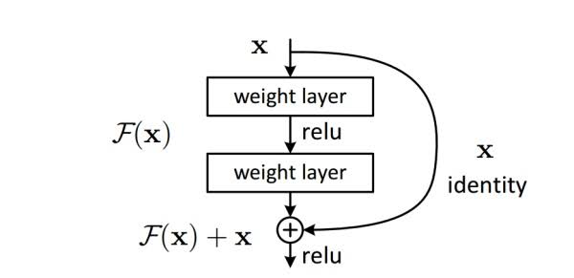
Residual Block

Slide 31
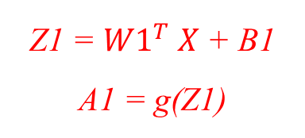
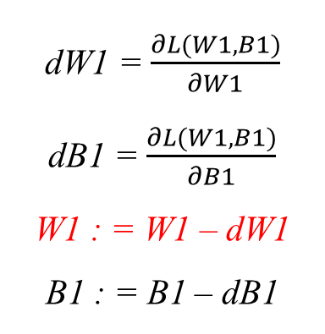
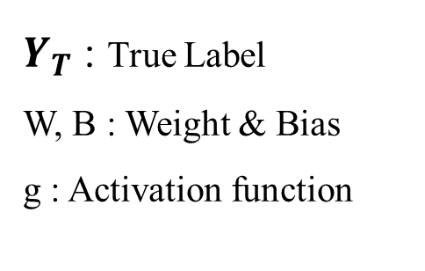
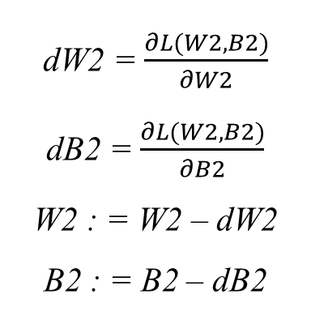
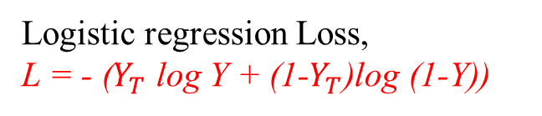
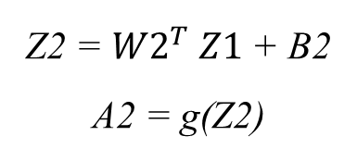
How Neural Network works ?
Forward Pass
$Y_{T}$ : True Label
W, B : Weight & Bias
g : Activation function
Z1 = ${W1}^{T} X$ + B1
A1 = g(Z1)
Z2 = ${W2}^{T} Z1$ + B2
A2 = g(Z2)
If relu activation,
A = max (0,Z)
Output , Y =A2
dW1 = $\frac{∂L(W1,B1)}{∂W1}$
dB1 = $\frac{∂L(W1,B1)}{∂B1}$
W1 : = W1 – dW1
B1 : = B1 – dB1
dW2 = $\frac{∂L(W2,B2)}{∂W2}$
dB2 = $\frac{∂L(W2,B2)}{∂B2}$
W2 : = W2 – dW2
B2 : = B2 – dB2
Logistic regression Loss,
L = - ($Y_{T}$ log Y + (1-$Y_{T}$)log (1-Y))
Input = X
Gradient Descent optimization
Back Propagation

Slide 32
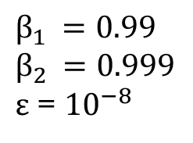
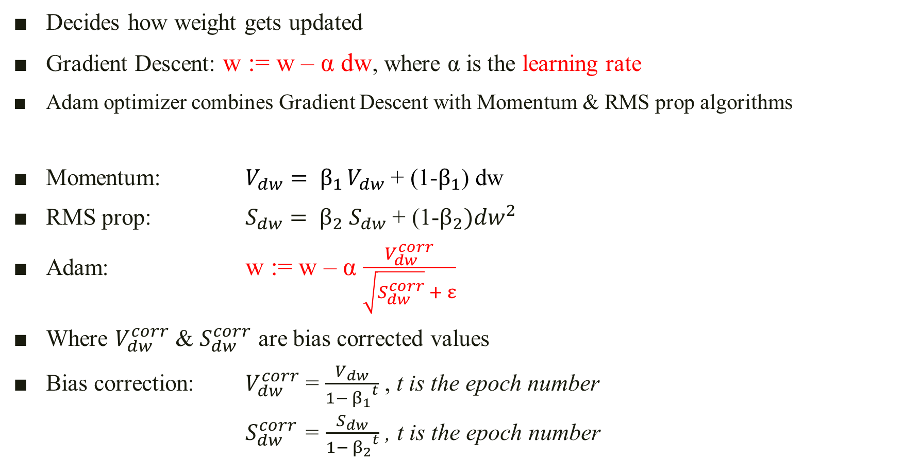
Optimization Algorithm
Decides how weight gets updated
Gradient Descent: w := w – α dw, where α is the learning rate
Adam optimizer combines Gradient Descent with Momentum & RMS prop algorithms
Momentum: $V_{dw}= β_{1 }V_{dw}$ + (1-$β_{1}$) dw
RMS prop: $S_{dw}= β_{2}{ S}_{dw}$ + (1-$β_{2}){dw}^{2}$
Adam: w := w – α $\frac{V_{dw}^{corr}}{\sqrt{S_{dw}^{corr}} + ε}$
Where $V_{dw}^{corr}$ & $S_{dw}^{corr}$ are bias corrected values
Bias correction: $V_{dw}^{corr}$ = $\frac{V_{dw}}{1− {β_{1}}^{t}}$ , t is the epoch number
$S_{dw}^{corr}$ = $\frac{S_{dw}}{1− {β_{2}}^{t}}$ , t is the epoch number
$$β_{1 }=0.99$$
$$β_{2 }=0.999$$
$ε$ = ${10}^{−8}$

Slide 33
Train – Val – Test split
 |  | Train Set | Validation Set | Test Set
Number of Images |  | 2217 | 238 | 54
Data Points Per Class | NOTSAFE | 882 | 96 | 19
 | NoHardhat | 779 | 72 | 17
 | NoJacket | 970 | 112 | 23
 | SAFE | 1040 | 115 | 27

Slide 34
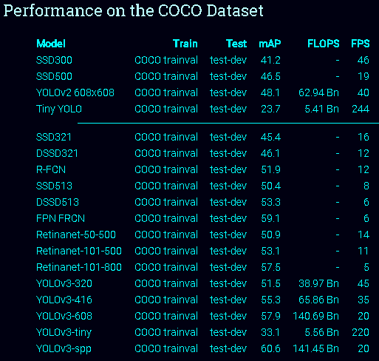
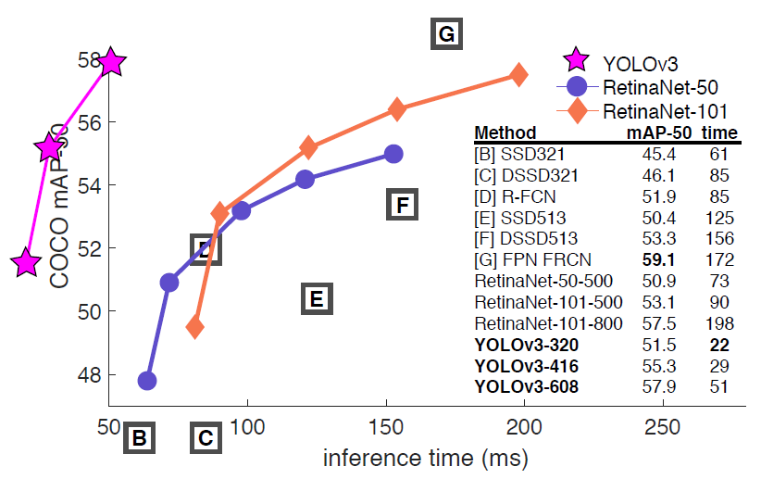
Why YOLOv3 ?
In YOLO Object detection framed as a regression problem
Whole detection pipeline is a single network
Can be optimized end-to-end directly on detection performance
Predicts boxes at three different scales
Good resolution spatial information on object locations
Shows significant improvement in detecting small objects
Extremely fast
Working Machine: Titan X
(GPU with 12 GB RAM)
Joseph Redmon and Ali Farhadi, 2018
Notes:
mean average precision is the metric to measure the accuracy of object detectors
floating point operations per second is a measure of computer performance,
Frames per second is frequency at which consecutive images called frames appear on a display.

Slide 35
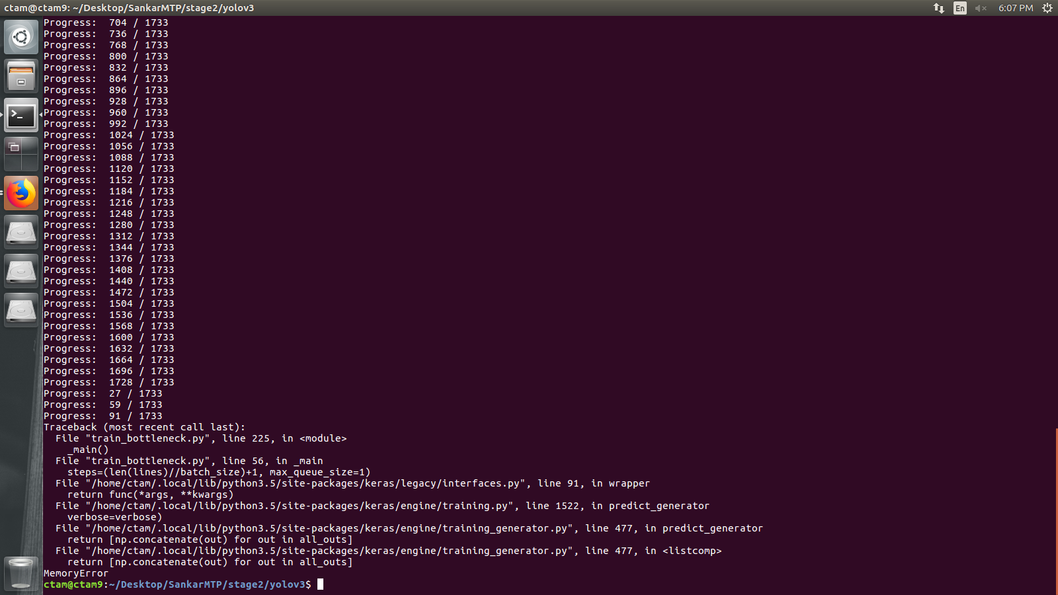
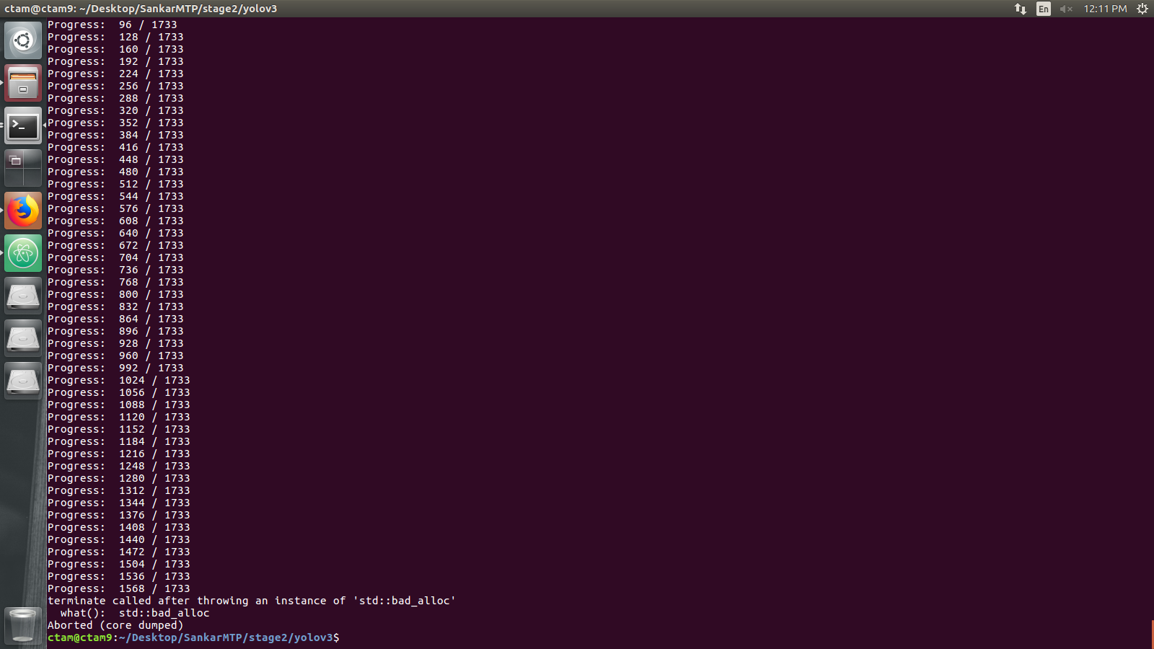
Error Message while training

Slide 36
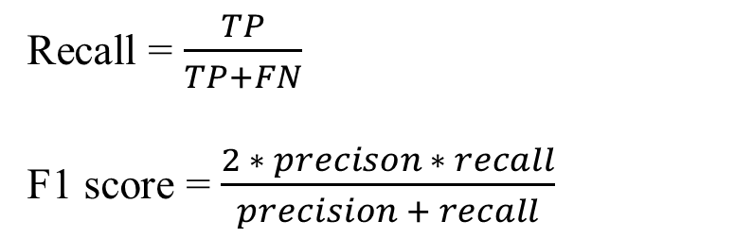
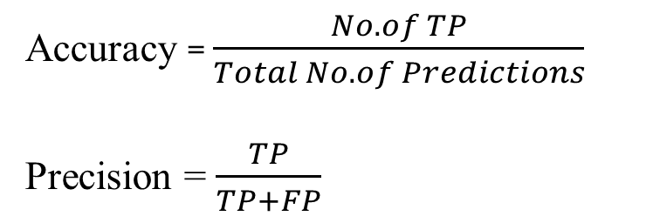
Performance Evaluation
Confusion Matrix (Test set)
 |  | HUMAN
 |  | NOTSAFE | NoHardhat | NoJacket | SAFE
MODEL | NOTSAFE | 19 | 0 | 1 | 0
 | NoHartdhat | 0 | 17 | 0 | 0
 | NoJacket | 0 | 0 | 21 | 1
 | SAFE | 0 | 0 | 1 | 26
True Positive (TP)
True Negative (TN)
False Positive (FP)
For NOTSAFE Class
False Negative (FN)
For NOTSAFE Class
Accuracy = $\frac{No. of TP}{Total No. of Predictions}$
Precision = $\frac{TP}{TP+FP}$
Recall = $\frac{TP}{TP+FN}$
F1 score = $\frac{2 ∗ precison ∗ recall}{precision + recall}$

Slide 37
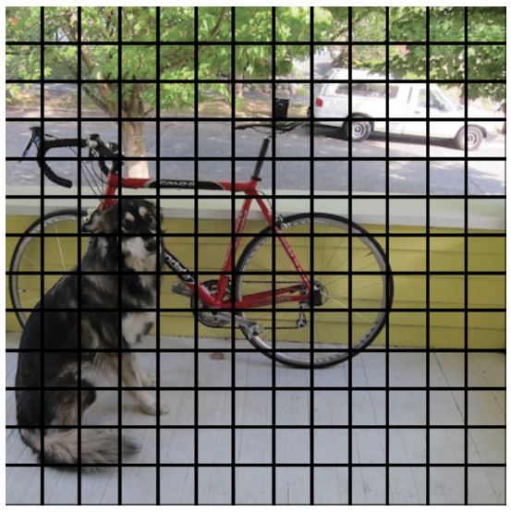
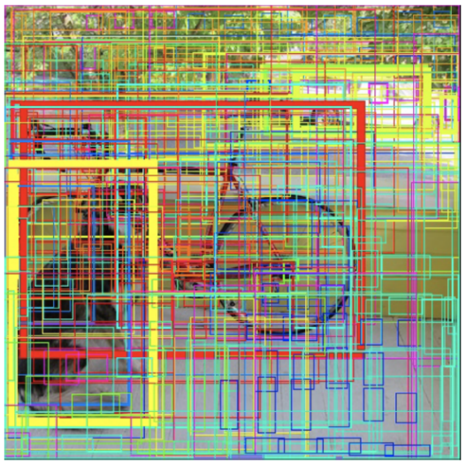

How YOLO does object detection?
Input image split into SXS grid
Create bounding boxes & predicts confidence for each box
Predict class probability for each cell
Multiply confidence value and class probability
Choose best prediction using Non maximal suppression
Joseph Redmon, Santosh Divvala, Ross Girshick and Ali Farhadi (2016)
Notes:
P(object), P(Class ! Object)
Confidence score- how confident the model is that the box contains an object and how accurate it thinks the box is that it predicts
For PASCAL VOC dataset
YOLO – 24 Conv layers, 2 FC layers,
7X7 grid,
2 bounding boxes for each cell
5 parameters
20 classes
7*7*(2*5+20) = 1470 parameters that the net predicts

Slide 38

Why Transfer learning ?
Higher start.
The initial skill (before refining the model) on the source model is higher than it otherwise would be.
Higher slope.
The rate of improvement of skill during training of the source model is steeper than it otherwise would be.
Higher asymptote.
The converged skill of the trained model is better than it otherwise would be.
With TL
Without TL
Ref: https://machinelearningmastery.com/transfer-learning-for-deep-learning//

Slide 39
System Configuration
Hardware
CPU: Intel Core i7-4790@3.60GHz *8
RAM: 8GB 1600MHz
Intel HD Graphics GPU
Environment
Python
Programming Language
PIP
Package Management System
Operating System
Computer Vision Library
Ubuntu 16.04
OpenCV
Computational Framework
Tensorflow
Text Editor
DL Framework
Atom
Keras
Image Annotation Tool
LabelImg-master
Notes:
application programming interface (set of communication commands)
Ubuntu is a free and open-source operating system and Linux distribution based on Debian
Python is an interpreted high-level programming language
pip is a package management system used to install and manage software packages written in Python
OpenCV is a library of programming functions mainly aimed at real-time computer vision
TensorFlow is an computational framework, object detection api
Keras is a high-level neural networks API, written in Python and capable of running on top of TensorFlow, CNTK, or TheanoThe Jupyter Notebook is an open-source web application that allows you to create and share documents that contain live code, equations, visualizations and narrative text

Slide 40
Previous Classifiers
Sliding window (VGGNet, Inception)
Region Proposals: First predict which parts of the image contain interesting information
In both approaches, we need to run the classifier many times

Slide 41
Pooling Layer
Maximum
Maximum
Max Pooling
1 | 3 | 2 | 1
2 | 9 | 1 | 1
1 | 3 | 2 | 3
5 | 6 | 1 | 2
9 | 9 | 2
9 | 9 | 3
6 | 6 | 3
9 | 9
9
Max Operator
OUTPUT
INPUT
FILTER: 2X2
Average
Average
Average Pooling
1 | 3 | 2 | 1
2 | 9 | 1 | 1
1 | 3 | 2 | 3
5 | 6 | 1 | 2
3.75 | 1.25
3.75 | 1.25
4 | 2
3.75
Average Operator
OUTPUT
INPUT
FILTER: 2X2
Stride: 2

Slide 42

Fully Connected Layer
Neurons in a FC layer have connections to all activations in the previous layer
High-level reasoning in the neural network is done here
Looks at what high level features most strongly correlate to a particular class and has particular weights
when we compute the products between the weights and the previous layer, we get the correct probabilities for the different classes
Ref: https://medium.com/reconstruct-inc/what-ai-can-do-for-progress-monitoring-b47526fece5f
Notes:
if the program is predicting that some image is a bird, it will have high values in the activation maps that represent high level features like wings or a beak, etc

Slide 43

Learning in Layers
First layers learn to identify simple lines and shapes
Second layer is more complex which naturally follows from the non-linearity between layers
This pattern for from all layers, more complex patterns are constructed as we reach the top layers in the CNN.
Andrew N G (2016)
Ref: http://bmia.bmt.tue.nl/people/BRomeny/Courses/Taipei2017/index.html

Slide 44
Non Maximal Suppression
Many bounding boxes for one object
Box with highest confidence selected
For remaining boxes, If IoU > 0.5, bounding box discarded
Andrew N G (2016)
https://www.pyimagesearch.com/2016/11/07/intersection-over-union-iou-for-object-detection/

